Slide 1

NBA Full Stack Application
Zihan Liu
Yuan Gao

Slide 2
Data Source
NBA_py (https://github.com/seemethere/nba_py)
Python client for NBA statistics
located at stats.nba.com
We use Python to scrap and pre-process the data using this client.

Slide 3
Database Schema
8 Tables
Player (person_id, name, country, height…)
Team_background (team_id, city, arena, headcoach…)
Player_team (player_id, team_id)
Game_info (game_id, game_date, season, away_team, home_team…)
Player_game (game_id, team_id, player_id, fgm, ast, reb…)
Player_season (player_id, season, team_id, fgm, ast, reb…)
Team_game (team_id, game_id, fgm, ast, reb…)
Team_season (team_id, season, win_percentage, conf_rank…)
8 Procedures
e.g. Get all games played on given date, get all players of a given team…
4 Triggers
Update team_season after update on team_game
Update team_season before/after delete on game_info
Update team_game after insert on game_info

Slide 4
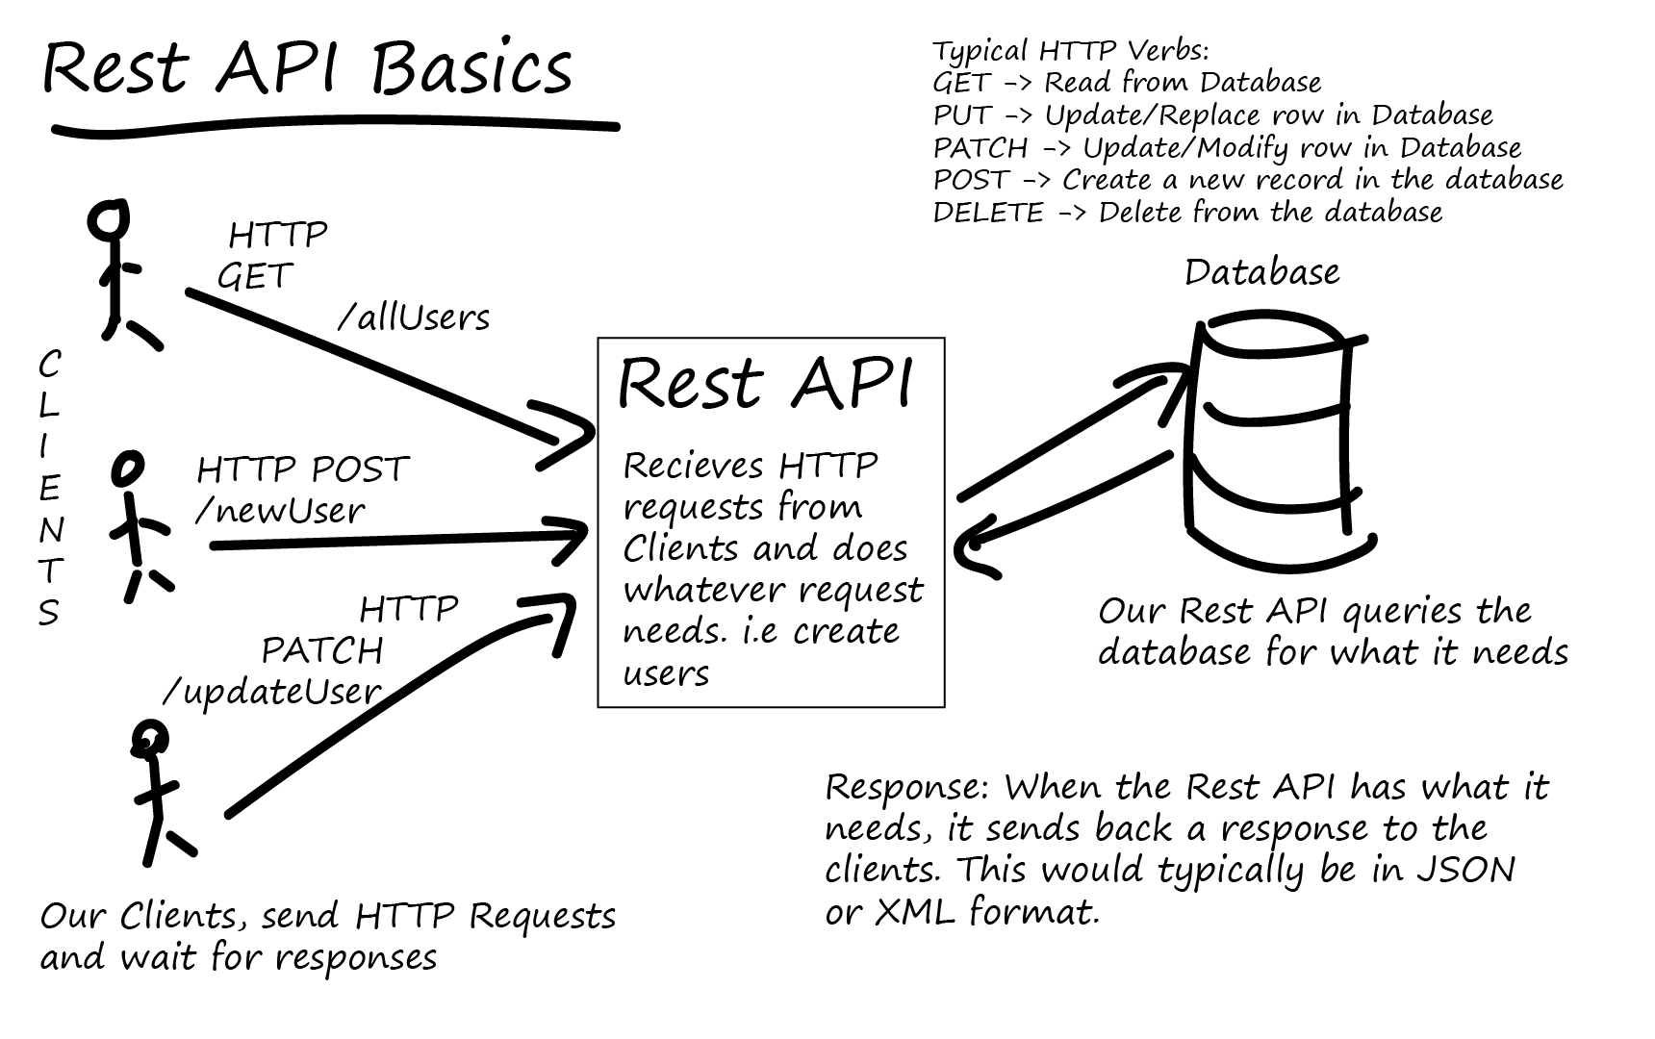
Architecture
FrontEnd Client: AngularJS
BackEnd RESTful API: SpringBoot
+ Spring data JPA
Database: MySql
Document: Swagger
http://total-qa.com/rest-services/

Slide 5
User functionality and Utility
C: Create Player, Create Game, Create Team.
R: All information stored in the Database can be retrieved.
U: Update Player, Update Team, Update team game stats.
D: Delete Player, Delete Team, Delete Game.

Slide 6
Demo
Insert a new game
Update game stats
of both teams
Display team_season and game information
Delete the game we just created, see team_season and game_info again
Notes:
Insert CEL – LAL
See game on that date
See team season of CEL
Update two teams points and fgm, fga(large number)
See team season win/loss, fgm, fga
Delete game inserted
See team season, games on that date.

Slide 7
Thanks!

